Slide 1
Supervised Learning:Classification
Nearest Neighbor Part-2

Slide 2
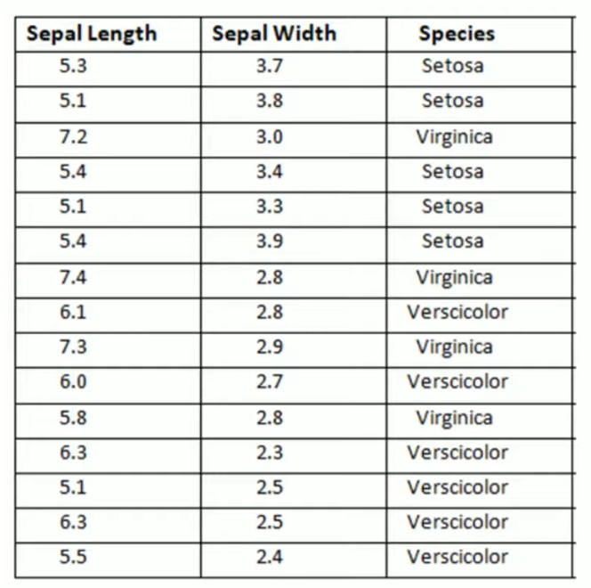
Consider the following dataset, apply KNN and tell the classification of sample point having sepal length=5.2 and sepal width =3.1

Slide 3
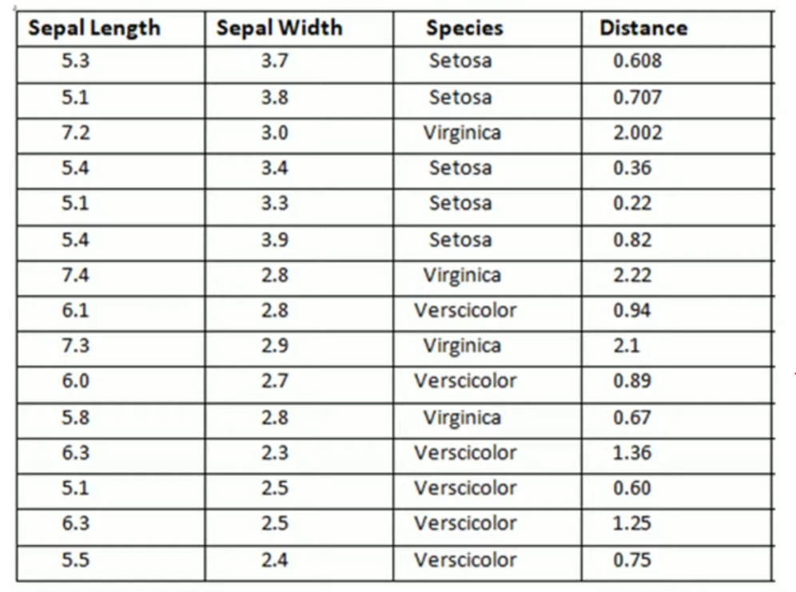
If k=1, setosa
If k=2, setosa if k=3,setosa

Slide 4
Diagnosing Breast Cancer with the k-NN Algorithm
We will utilize the Wisconsin Breast Cancer Diagnostic dataset.
The breast cancer data includes 569 examples of cancer biopsies, each with 32 features.
One feature is an identification number, another is the cancer diagnosis, and 30 are numeric-valued laboratory measurements.
The diagnosis is coded as "M" to indicate malignant or "B" to indicate benign.

Slide 5
Download the wisc_bc_data.csv file and save it to your R working directory.
Save the Wisconsin breast cancer data to the wbcd data frame:
> wbcd <- read.csv ("wisc_bc_data.csv", stringsAsFactors = FALSE)
If we want to find the structure of wbcd, execute:
> str(wbcd)

Slide 6
The first variable is an integer variable named id. As this is simply a unique identifier (ID) for each patient in the data, it does not provide useful information, and we will need to exclude it from the model.
> wbcd <- wbcd[-1]
The next variable indicates whether the example is from a benign or malignant mass. The table() output indicates that 357 masses are benign while 212 are malignant:

Slide 7
> table(wbcd$diagnosis)
We will need to recode the diagnosis variable.
> wbcd$diagnosis<- factor(wbcd$diagnosis, levels = c("B", "M"), labels = c("Benign", "Malignant"))
Now, when we look at the prop.table() output, we notice that the values have been labeled Benign and Malignant with 62.7 percent and 37.3 percent of the masses, respectively:

Slide 8
> round(prop.table(table(wbcd$diagnosis)) * 100, digits = 1)
The remaining 30 features are all numeric.
>summary(wbcd[c("radius_mean", "area_mean", "smoothness_mean")])
Now here we can see that the impact of area is going to be much larger than the smoothness in the distance calculation.

Slide 9
To normalize these features, we need to create a normalize() function.
> normalize <- function(x) {
return ((x - min(x)) / (max(x) - min(x)))
}
We can now apply the normalize() function to the numeric features in our data frame.
The lapply() function takes a list and applies a specified function to each list element.

Slide 10
> wbcd_n <- as.data.frame(lapply(wbcd[2:31], normalize))
To confirm that the transformation was applied correctly, let's look at one variable's summary statistics:
> summary(wbcd_n$area_mean)
We will use the first 469 records for the training dataset and the remaining 100 to simulate new patients

Slide 11
we will split the wbcd_n data frame into wbcd_train and wbcd_test:
> wbcd_train <- wbcd_n[1:469, ]
> wbcd_test <- wbcd_n[470:569, ]
When we constructed our normalized training and test datasets, we excluded the target variable, diagnosis.
For training the k-NN model, we will need to store these class labels in factor vectors, split between the training and test datasets:

Slide 12
> wbcd_train_labels <- wbcd[1:469, 1]
> wbcd_test_labels <- wbcd[470:569, 1]
To classify our test instances, we will use a k-NN implementation from the class package, which provides a set of basic R functions for classification.
> install.packages("class")

Slide 13
To load the package during any session in which you wish to use the functions, execute
> library(class)
Now we can use the knn() function to classify the test data:
> wbcd_test_pred <- knn(train = wbcd_train, test = wbcd_test, cl = wbcd_train_labels, k = 21)

Slide 14
The knn() function returns a factor vector of predicted labels for each of the examples in the test dataset, which we have assigned to wbcd_test_pred.
The next step of the process is to evaluate how well the predicted classes in the wbcd_test_pred vector match up with the known values in the wbcd_test_labels vector.
To do this, we can use the CrossTable() function in the gmodels package.

Slide 15
> install.packages("gmodels")
Load the package using,
> library(gmodels)
> CrossTable(x = wbcd_test_labels, y = wbcd_test_pred, prop.chisq=FALSE)

Slide 16
Algorithm
Read the given dataset wbcd
Display the structure and analyze it
Remove id column
Find the number of B and M samples
Recode the B and M labels to “Benign” and “Malignant”
Generate the summary of "radius_mean", "area_mean", "smoothness_mean“
Apply normalization (as value of area is much larger than smoothness)

Slide 17
8. The lapply() function takes a list and applies a specified function to each list element excluding ‘diagnosis’.
9. Check the values of area_mean after normalization
10. Split the dataset into training and testing phase
11. Apply knn
12. Apply crosstable() function to to evaluate how well the predicted classes in the wbcd_test_pred vector match up with the known values in the wbcd_test_labels vector.

